Slide 1
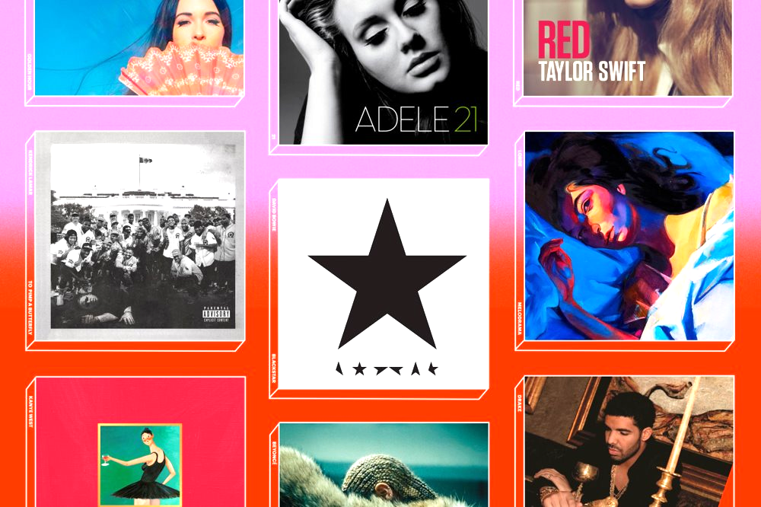
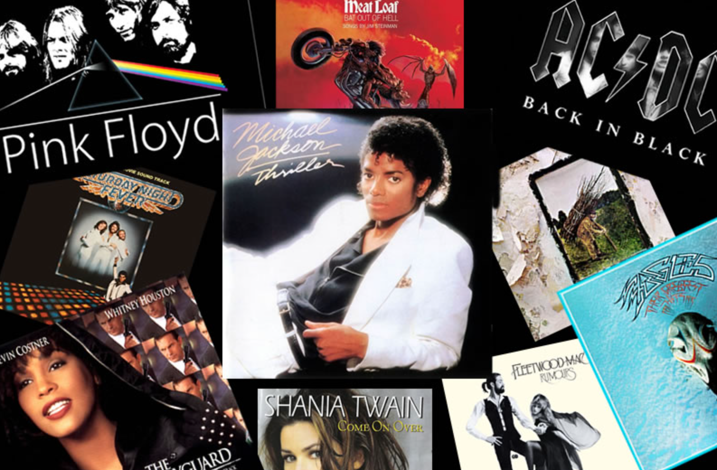
Top Hit Songs Data Analysis & Visualization
STATS401 Project 1: Chenglin Zhang, Yijia Xue, Yushan Gu

Slide 2
TABLE OF CONTENTS
01
INTRO
02
METHODS
03
RESULTS
04
CONCLUSION
Introduction of our project and our visualization goals
How we crawl, clean and process the data
A brief analysis of the visualization results
Conclusion & Further implications

Slide 3


INTRODUCTION
By investigating the question of who (artists) and what (genre, audio features, etc.) is leading the ever-changing musical trend, we can get valuable insights into the development of music. Specifically, by focusing on Billboard Hot 100, we have the following 5 visualization goals:
The variation of genres. Area Chart.
The evolution of the top hits’ audio features. Radar Chart.
Who the dominant artists are on the chart. Stacked Bar Chart.
What the top artists’ golden time is. Lollipop Chart.
Top artists’ musical preference (w.r.t. keys of songs). Sankey Chart.

Slide 4


METHODS
We used Scrapy to crawl the weekly Billboard Hot 100 chart from 1960/01/04 to 2022/04/02. There are 324787 records in total. We filtered the data by each record’s weeks on chart data (as an indicator of popularity). For each year, we retrieved the top 50 songs with respect to their weeks on chart. There are 3150 records after we filtered the data.
Then, we used the Spotify for Developers API to retrieve the data of each song’s audio features such as danceability, acousticness, loudness, key (pitch class), artist’s genre, tempo, valence (positiveness of the song), etc. After the API query, for each record, we have 21 attributes in total.

Slide 5
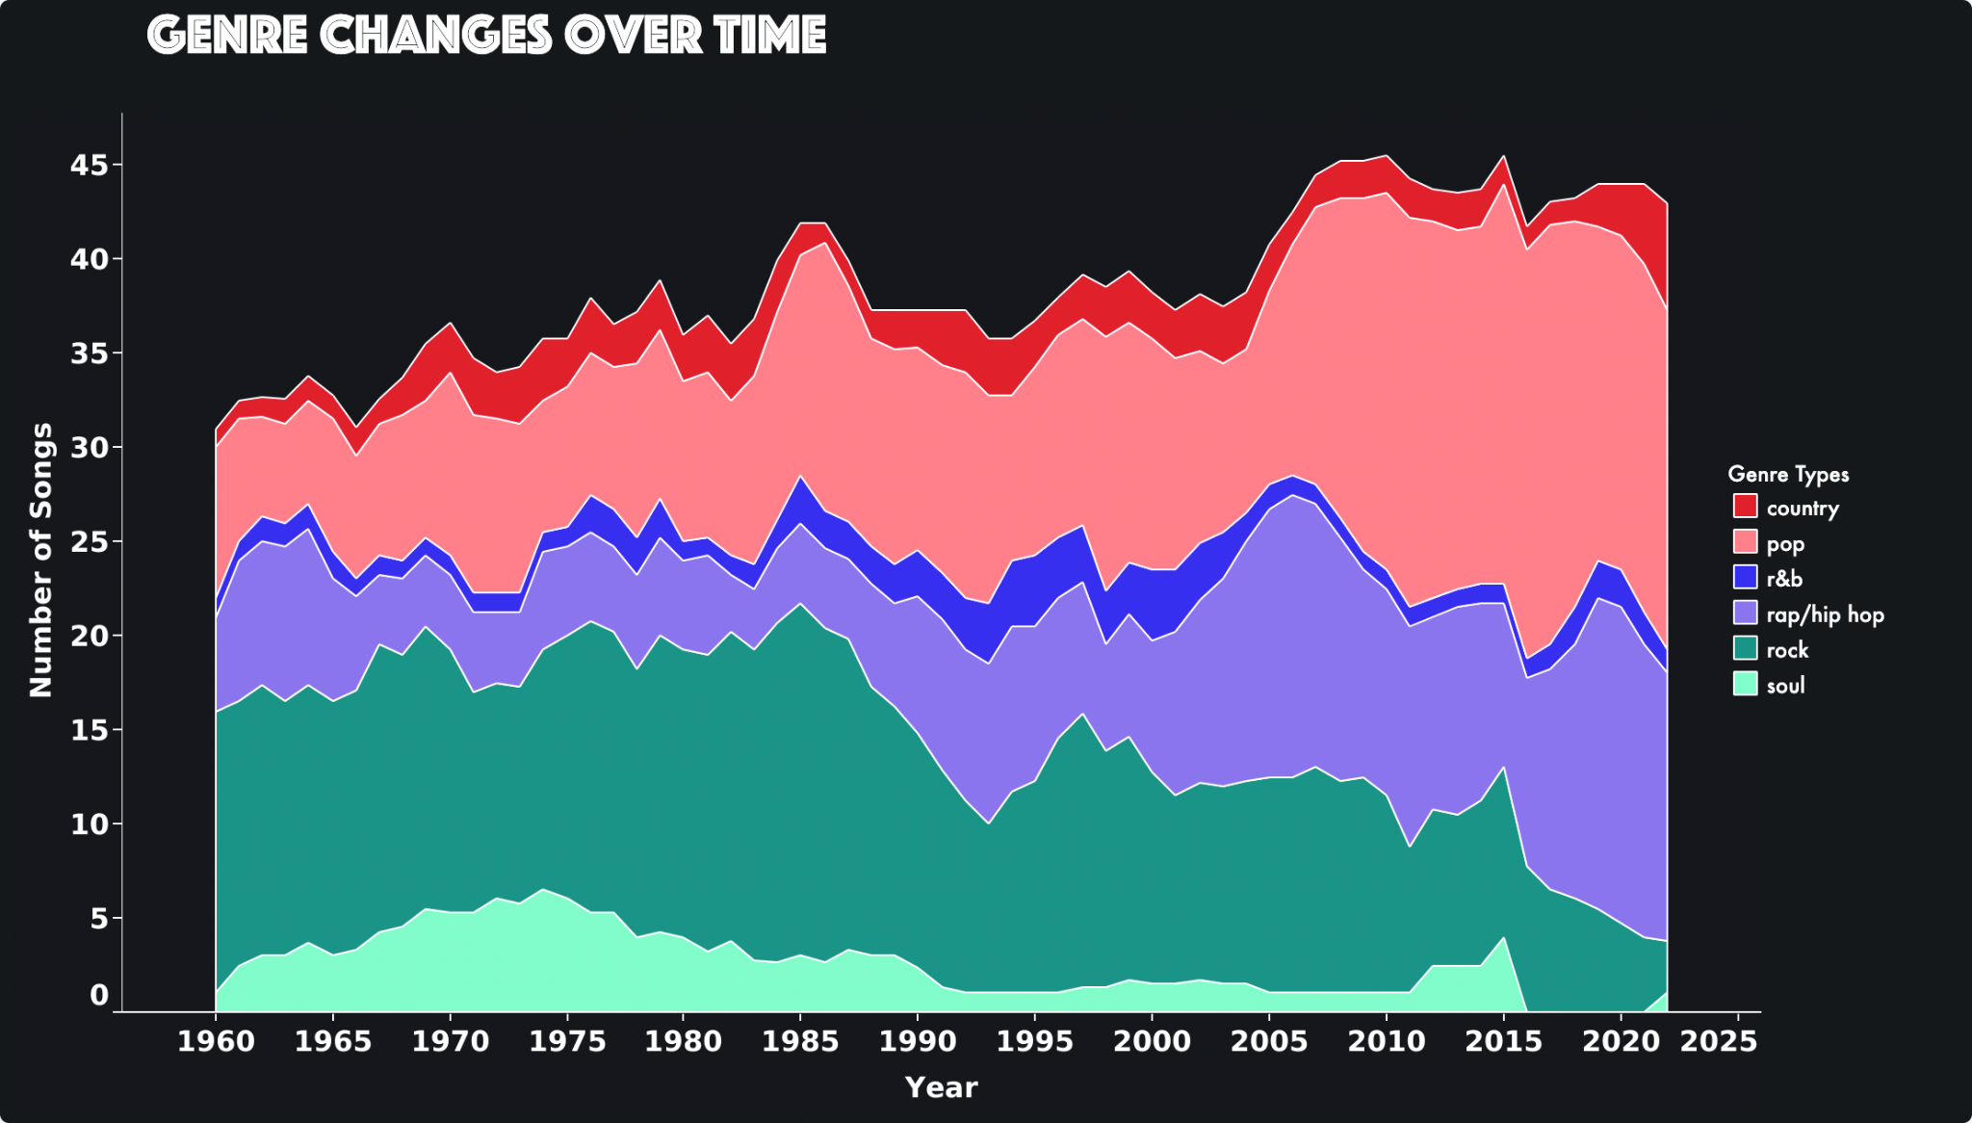

Slide 6
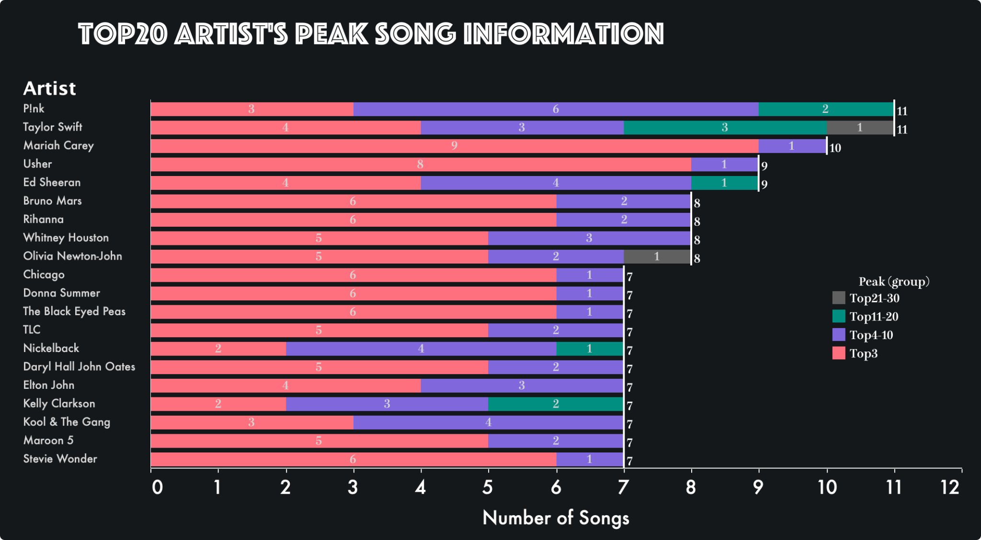

Slide 7
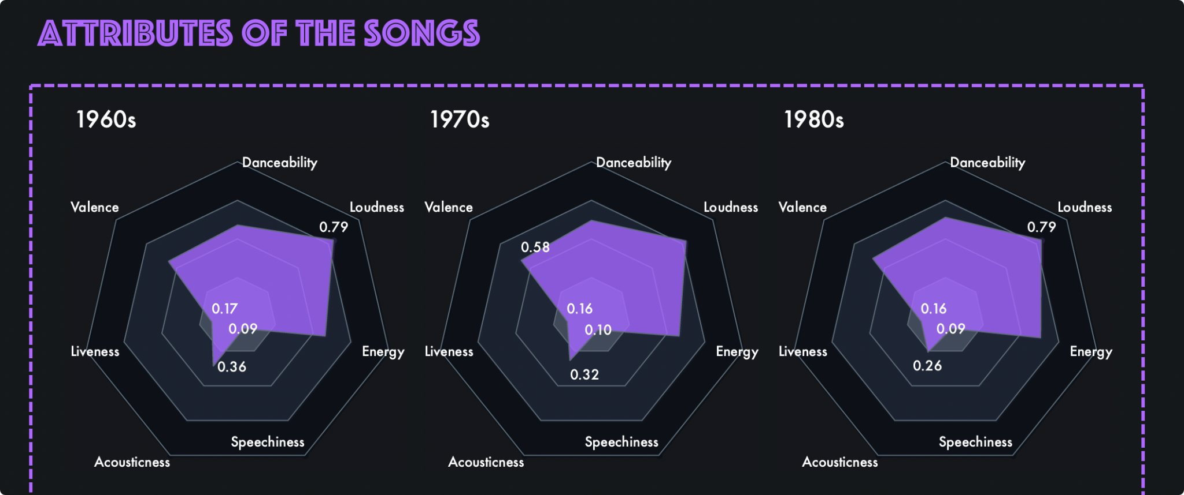
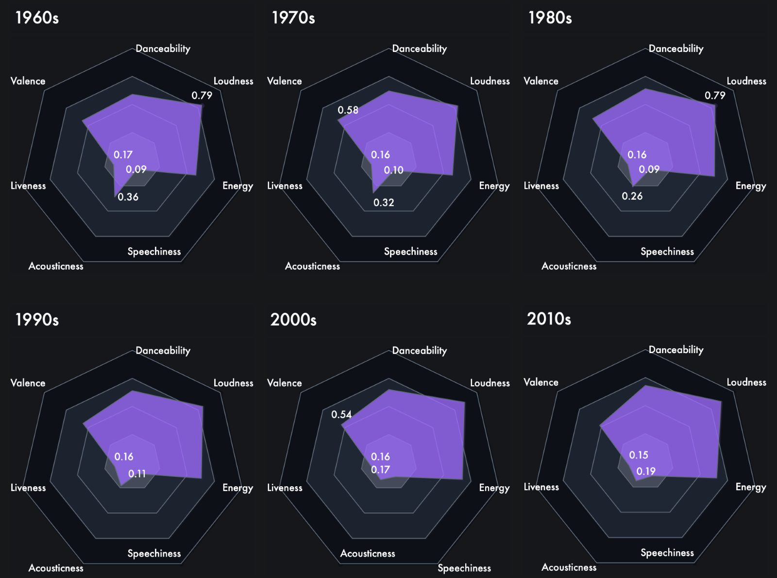

Slide 8
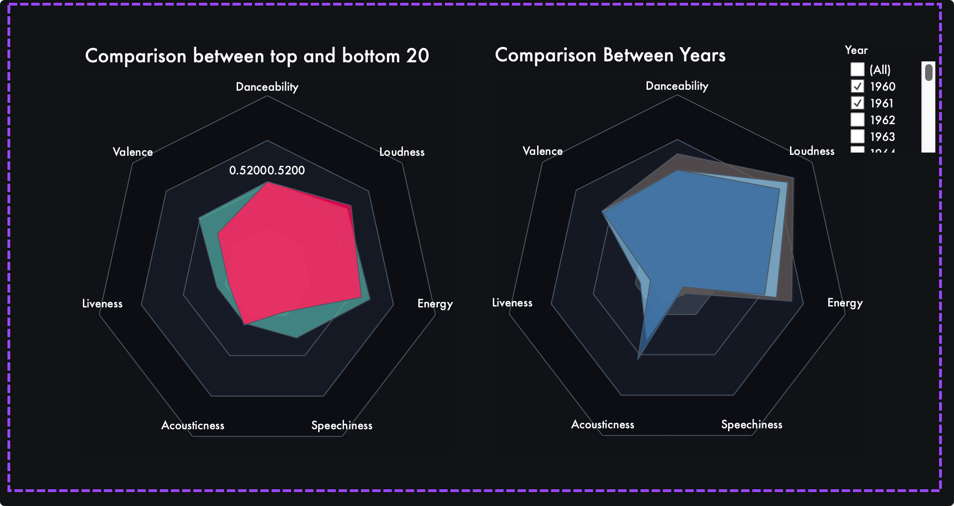

Slide 9
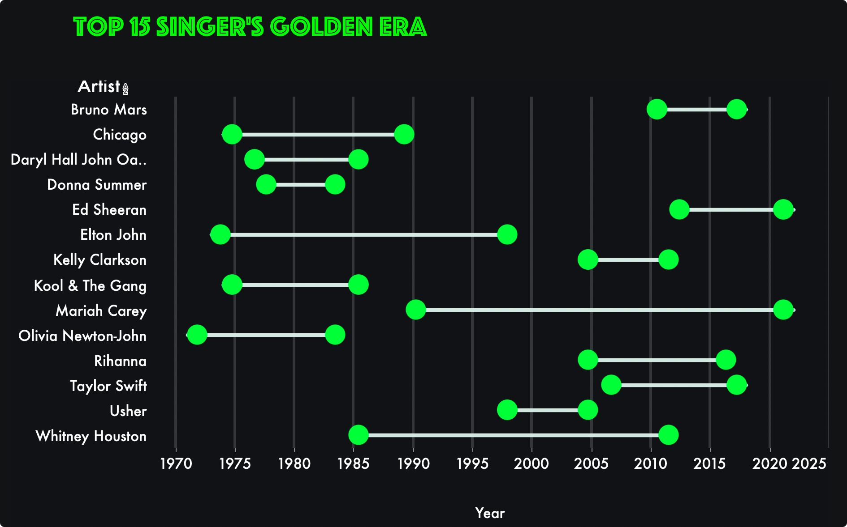

Slide 10
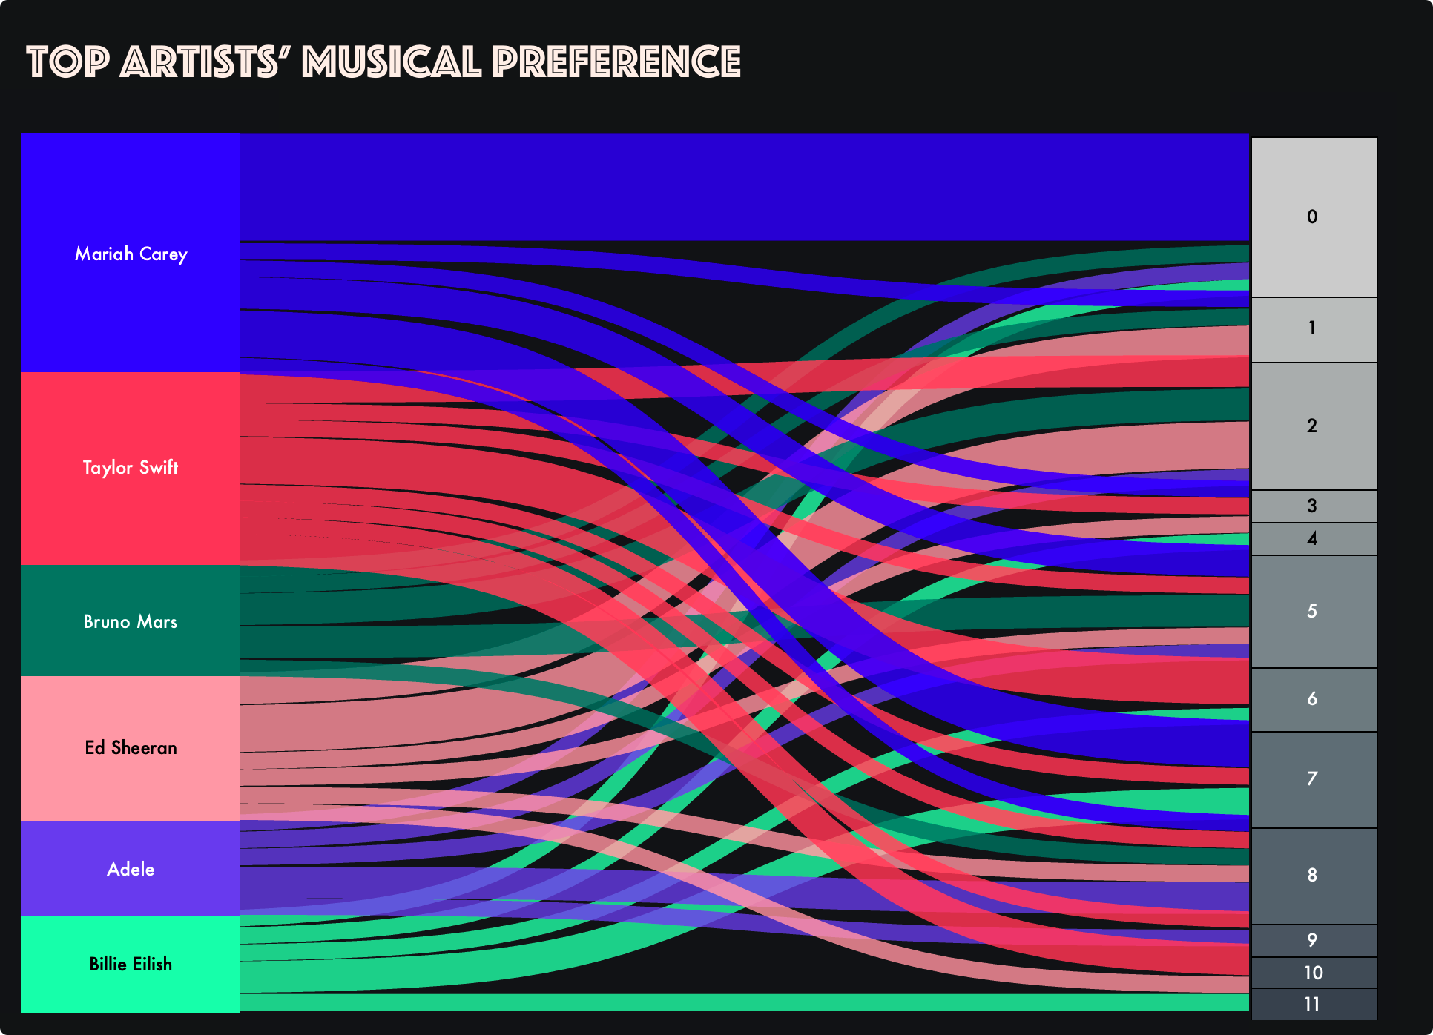

Slide 11
Thank You!

